Slide 1
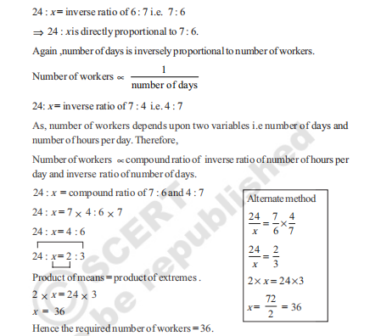
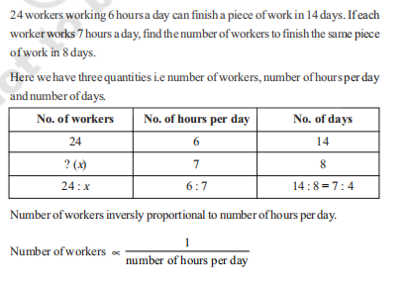
COMPOUND PROPORTION
10.3 Compound Proportion
Some times change in one quantity depends upon the change in two or more quantities in some
proportion. Then we equate the ratio of the first quantity to the compound ratio of the other two
quantities.
(i) One quantity may be in direct proportion with the other two quantities.
(ii) One quantity may be in inverse proportion with the other two quantities
(iii) One quantity may be in direct proportion with the one of the two quantities and in inverse
proportion with the remaining quantity.

Slide 2
Design notes
Need information box at top
Box for displaying the problem
Separate section for answer. Within the answer, need a table like shown in the example
Also need a box to show the alternative method.
Programming notes – problem description will remain same.
Answer box will show up when check answer is clicked. We will reduce the text

